Slide 1
Intern Placement Tracking (IPT) Tutorial for Field Instructors
The University of Tennessee, Knoxville
College of Social Work
BSSW and MSSW Programs
www.csw.utk.edu

Slide 2
IPT Overview
The Intern Placement Tracking (IPT) system is a web-based software system designed to keep track of student field placements and field forms. This system also serves as the database for all field placement organizations and field instructors.
Some key benefits of IPT:
Provides students with access to their own personal pages to enter personal and emergency contact information for their field instructors. You will be able to access your student’s page.
Provides Field Instructors, Liaisons, and students with 24/7 online access to their own field forms, including the time sheet and learning plan & evaluation form. You will complete and sign all field forms online. Once completed, these forms are submitted and archived online.
Privacy Notice: Although this is a web-based program, none of your personal information is available to the general public. Your information is password protected and the only people who may view your information are the field support team at the CSW and your students.

Slide 3
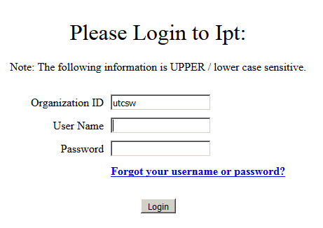
Getting Started
The IPT website is located at: www.runipt.com (please bookmark this page).
Three fields are required for login: organization ID, user name, and password. All information entered in these fields is case sensitive.
The organization ID for everyone using our IPT system is: utcsw
The CSW will supply all field instructors with a temporary (default) user name and password.
You will be prompted to set a new username and password after your initial login. If you forget either your user name or password please contact your field support staff to have them reset to the default.
NOTE: IPT does not always work well with Safari. If you have a Mac and are having problems with Safari, try Mozilla Firefox, Internet Explorer or Google Chrome.

Slide 4
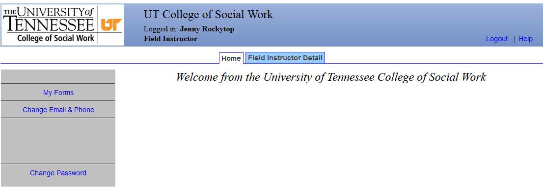
IPT Home Page
The Home Page is the starting point for accessing the information and functions of the IPT system.
Make sure that your name appears in the blue banner at the top of the page.
In the gray section of the page, on the left-hand side, you should see links for the following:
My Forms
Change Email & Phone
Change Password
In the middle of the page, you should see the following tabs:
Home
Field Instructor Detail
The first time you enter into the IPT system you should click on the Field Instructor Detail tab to access your own information.

Slide 5
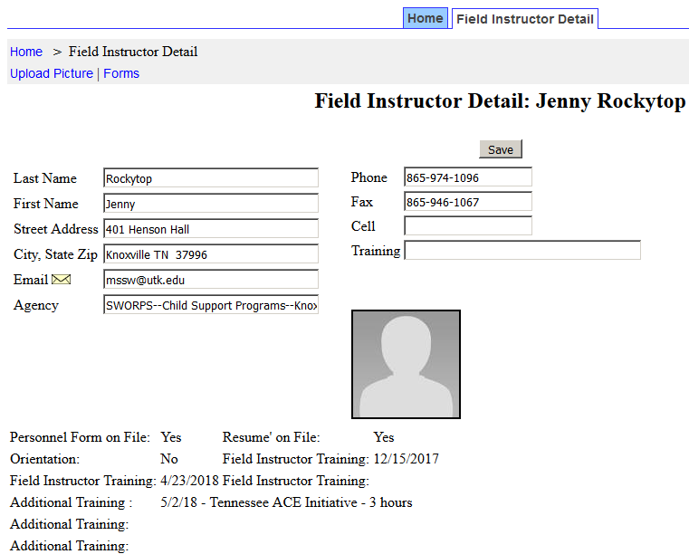
Field Instructor Detail Page
The Field Instructor Detail page provides the CSW with the most current address and contact information for you and your agency. When your profile was created, your name, email, phone number and agency were entered for you. Please update as needed to make sure this information is correct and current. Be sure to click the “Save” button after making any changes.
You will also be able to see any documented trainings you attended through the CSW.
You have the option of uploading a photo of yourself to your detail page. Use the “upload picture” link at the upper left-hand side to access this feature. Your photo must be less than 100 MB in size to upload correctly.

Slide 6
Field Instructor Detail Page (continued)
Internship Assignments- this section of the detail page lists all the students who are currently placed at your agency and assigned to you as their field instructor. If you need student contact information, click on “View” to the left of their name and you will be directed to their Student Detail Page.

Slide 7
IPT Field Forms
The forms function is one of the most important aspects of IPT.
Forms are online documents that allow students, field instructors, field liaisons and field coordinators to complete and review field materials electronically rather than in hardcopy.
To access or view your field forms simply click on “My Forms” on your IPT Home page. This will open your online forms list.
Once signed, the form (or form section) is locked and changes can no longer be made. A signed form can still be viewed by the user, but no changes can be made. Final signatures lock the entire form.
You can click the “Hide Completed Forms” checkbox to remove completed forms from previous semesters from your forms list.

Slide 8
Learning Plan & Evaluation Forms
The learning plan serves as a guide to direct and monitor the student’s learning and the Field Instructor’s teaching. The learning plan is a contract between the student and the Field Instructor, so both parties must commit to the plan.
A learning plan is developed at the beginning of each semester. All assignments listed on the plan are to be completed by the end of that semester. Assignments may be repeated on subsequent plans for continued development of mastery. BSSW and MSSW Generalist learning plans include required assignments. All assignments on MSSW Concentration learning plans are developed by the Field Instructor and the student.
The student is responsible for entering the agency-specific assignments in the Learning Plan Assignments column in IPT. When that column is complete, both the Field Instructor and student sign under “Learning Plan” at the end of the form.
SAVE YOUR WORK! You must click on the “SAVE” button to save any information entered or changed before closing, or your information will be lost.
Evidence of Assignment Completion- Completed by the Student
The student is to document activities related to assignment completion and enter this information into the Evidence of Assignment Completion column.
Students must enter evidence for completion of all assignments by the end of the semester in order for field instructors to assign final ratings.

Slide 9
Learning Plan & Evaluation Forms (continued)
Evaluation Directions - The Field Instructor is responsible for completing evaluations of student performance. The Field Instructor is to discuss the evaluation with the student to provide feedback targeted at student growth and development. Field Instructors are expected to provide summary feedback on student performance and competency in the Evaluation Comments section. Students may enter comments about the evaluation and/or their field experience in the comments sections.
The Field Instructor will complete a Mid-term evaluation for all students except MSSW Generalist students in the fall semester. The Field Instructor should review the student’s entries in the Evidence column to complete the evaluation.
Final (End of Semester) Ratings-Completed by Field Instructor - The Field Instructor is to assess the student’s demonstrated competency for each practice behavior, reviewing the evidence provided by the student and using the evaluation rating scale. The student should review the evaluation, enter comments and sign the learning plan first.

Slide 10
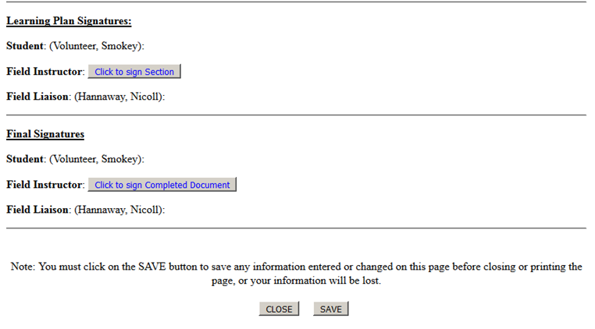
Learning Plan & Evaluation Forms (continued)
The Field Instructor should not sign until the student has had the opportunity to review the evaluation, enter comments, and sign the evaluation. The Field Instructor should enter the final signature when all evidence, ratings, and comments have been entered. A final signature locks the form.

Slide 11
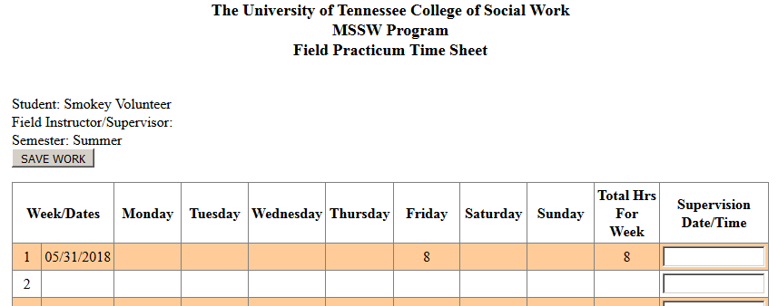
Time Sheets
Each student is responsible for maintaining an accurate record of their time by entering the beginning and ending time for each day they are at their field placement.
Students list dates in first column (either the beginning date or week).
Students list times they were at placement under daily columns. Hours should not be entered before they are actually completed. Students enter a total number of hours each week (in decimals) in the “Total Hours for Week” column. A cumulative total of hours can be found at the bottom of the column.
Field Instructors are to review the time sheet and enter the supervision date/time on a weekly basis.

Slide 12
Time Sheets (continued)
Students should be prompt in entering their daily hours and should do so before the Field Instructor enters the supervision time/date at the end of the week. Please note that this serves as your digital signature and approval of hours for that week.
If you are away from work during a week and unable to provide supervision, you may enter the reason you were unable to provide supervision (e.g. illness, vacation) in the box to approve the hours.
Please do NOT sign the time sheet until the end of semester after all hours have been entered and approved. After signing the form, no changes or additions can be made.
Don’t forget to click “Save”!

Slide 13
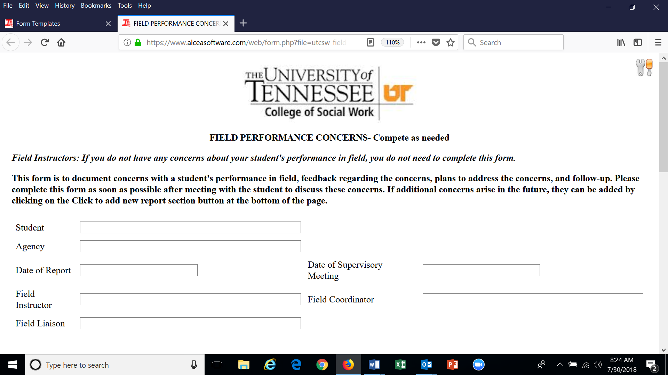
Field Concerns Report
A Field Concerns Report is loaded into your student’s forms every semester. This report is to be used only if you have concerns about your student’s performance or conduct in field. Please use this form to document concerns, feedback given, and follow-up.
If you have additional concerns after resolution of the initial concern, click on Add New Report at the bottom of the form, and you can enter new information about concerns, feedback, and follow-up.

Slide 14
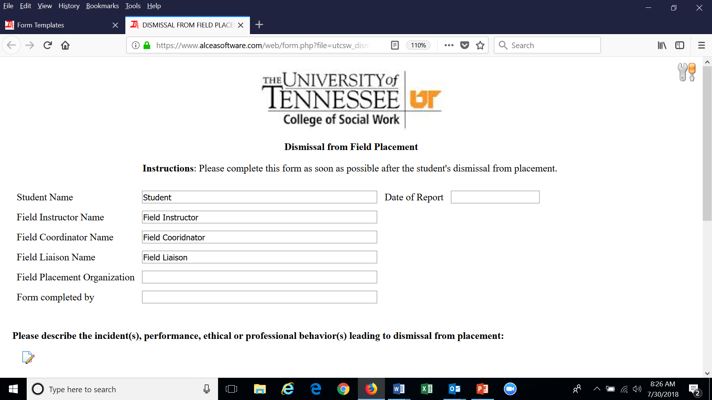
Dismissal Form
If you make a decision to dismiss your student from placement, please contact your Field Coordinator to notify her and to request that a Dismissal Form be uploaded in your student’s forms list.
Please enter in the dismissal form specific information regarding the cause of dismissal, including dates and any feedback that was provided to the student regarding the issues.
Your documentation is critical in informing the Field Coordinator’s decision as to whether the student is eligible for another placement or will be assigned a grade of No Credit and dismissed from the program.

Slide 15
Field Staff Contact Information
Director of Field Education
Kim Mallory, kcrane@utk.edu, 865-974-8984
Knoxville Campus
Associate Director of Field Education and BSSW Field Coordinator: Kim Denton, kddenton@utk.edu, 865-974-6677
MSSW Coordinator: Martina Ward, mward21@utk.edu, 865-974-7512
Online BSSW & CSW Agency Recruitment: Brittany Adams, blong8@utk.edu, 865-974-7502
Field Support Staff: Hannah Collins, hbrown22@utk.edu, 865-974-3175
Nashville Campus
MSSW Field Coordinator: Allison Diehl, amilam7@utk.edu, 615-432-5248
Field Support Staff: Cassidy Hebert, chebert8@utk.edu, 615-782-6153
Distance Education (Online)
MSSW Field Coordinator: Tami Walker, twalker7@utk.edu, 615-988-9488
MSSW Field Coordinator: Alicia Hirt, ahirt2@utk.edu, 615-782-5192
Field Support Staff: Cassidy Hebert, chebert8@utk.edu, 615-782-6153
MSSW Field Coordinator: Rachel Ross, rcooper7@utk.edu
Field Support Staff: Hannah Collins, hbrown22@utk.edu, 865-974-3175

Slide 16
Thank you!
Please contact us if you need assistance with IPT or any field related issues.
We appreciate you and all you do for our students!

